Slide 1


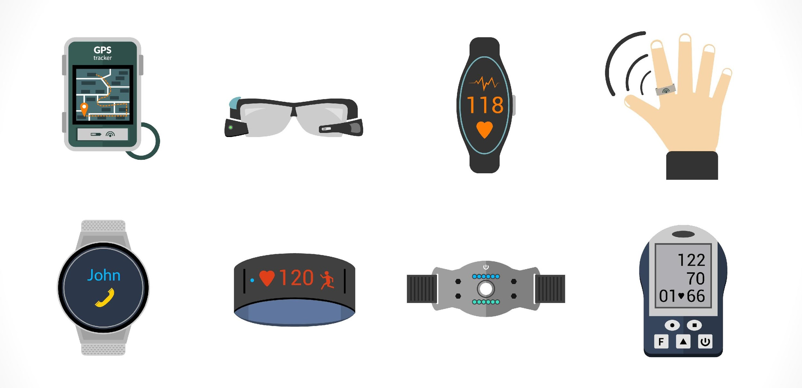
SCIENTISTS USE AI TO PREDICT BIOLOGICAL AGE BASED ON SMARTPHONE AND WEARABLES DATA
HERMMY WANG

Slide 2
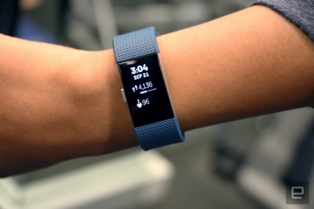
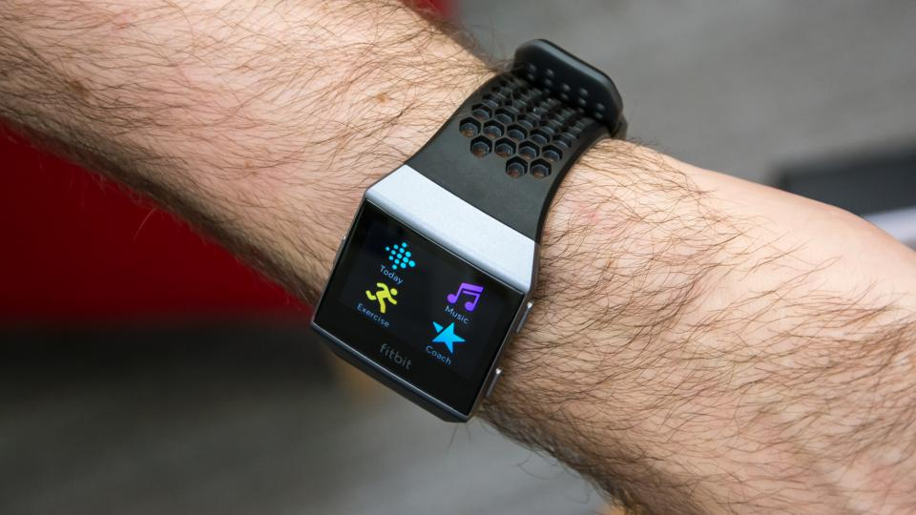
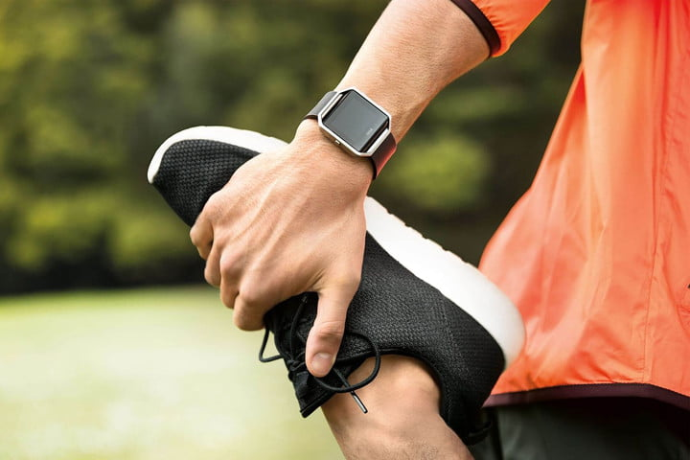
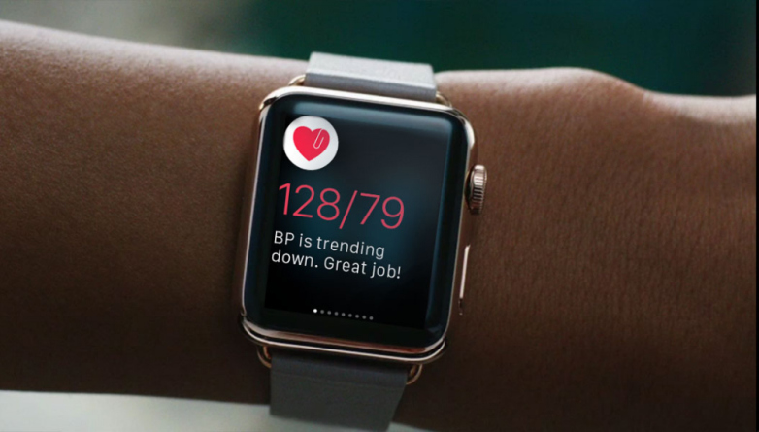

Slide 3
INTRODUCTION
March, 2018
GERO Biotech & Moscow Institute of Physics and Technology
A computer algorithm that predicts biological age and mortality risk based on physical activities
Combine wearable sensors and AI technologies to monitor health risks with real-time feedback to patients and care providers
Team leader: Peter Fedichev, Ph.D.
The head of the Laboratory of Biological Systems Simulation at MIPT
GERO Science Director

Slide 4


“Recent promising examples [of Artificial Intelligence] in the field of medicine include neural networks showing cardiologist-level performance in detection of the arrhythmia in ECG data, deriving biomarkers of age from clinical blood biochemistry, and predicting mortality based on electronic medical records. Inspired by these examples, we explored AI potential for Health Risks Assessment (HRA) based on human physical activity.”
Peter Fedichev

Slide 5
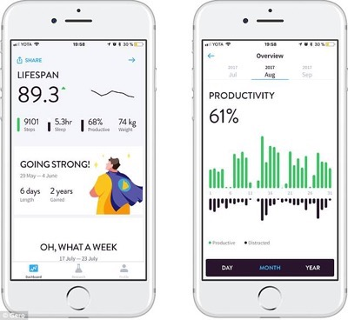
GERO LIFESPAN

Slide 6
WHAT ALGORITHM DO THEY USE?
HOW DOES IT WORK?

Slide 7
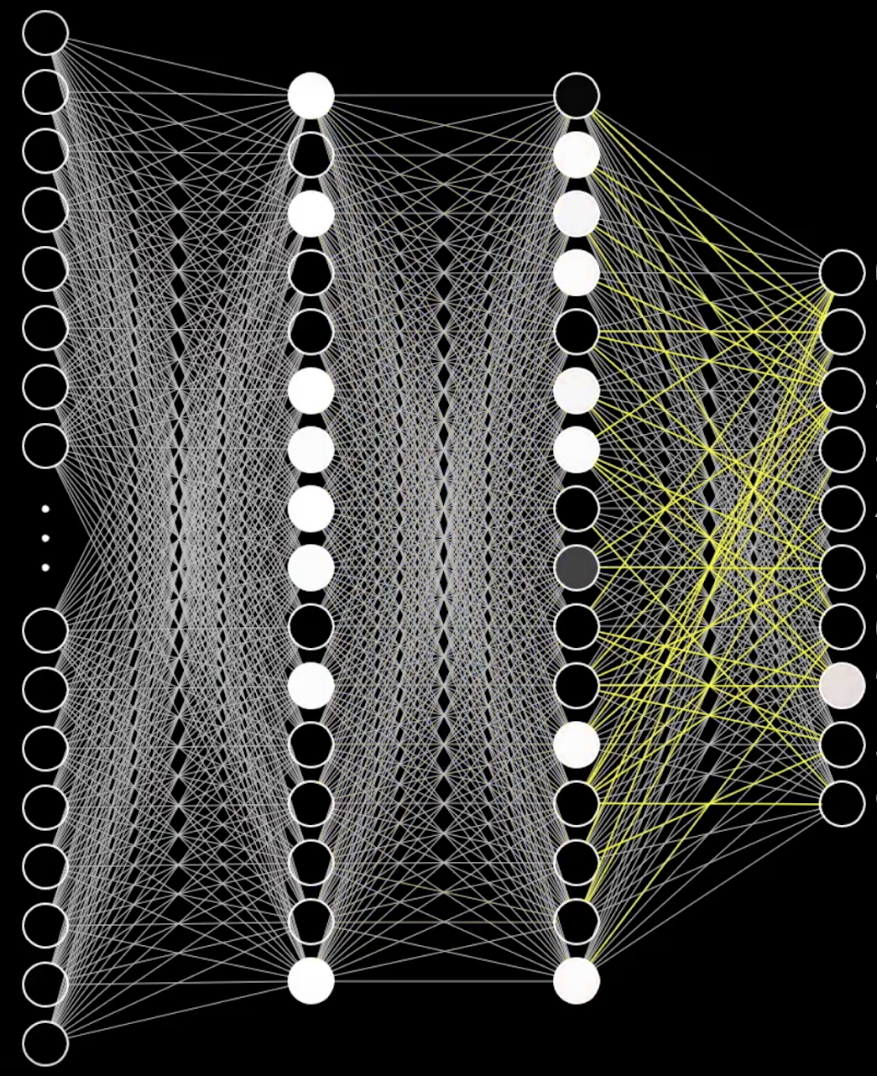
CONVOLUTIONAL NEURAL NETWORK
Machine Learning
Pattern recognition
An artificial neural network that contains multiple convolution layers to detect patterns
Each convolution layer consists of many neurons that have learnable weights and biases.
It is inspired by biological processes in that the connectivity pattern between CNN neurons resemble to the organization of animal’s neural network.

Slide 8
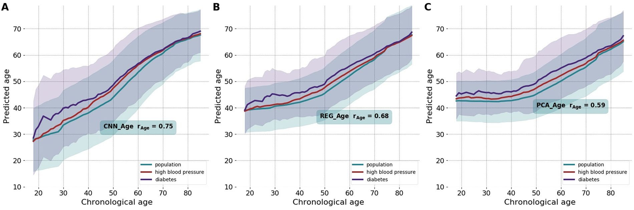
DEEP CNN_AGE MODEL
The researches build three age-estimating models:
Deep convolutional neural network (CNN_Age model)
Regularized multivariate regression (REG_Age model)
Principal component analysis (PCA_Age model)
CNN_Age outperforms REG_Age and PCA_Age in terms of the chronological age prediction accuracy.

Slide 9
WHAT ALGORITHM DO THEY USE?
HOW DOES IT WORK?

Slide 10
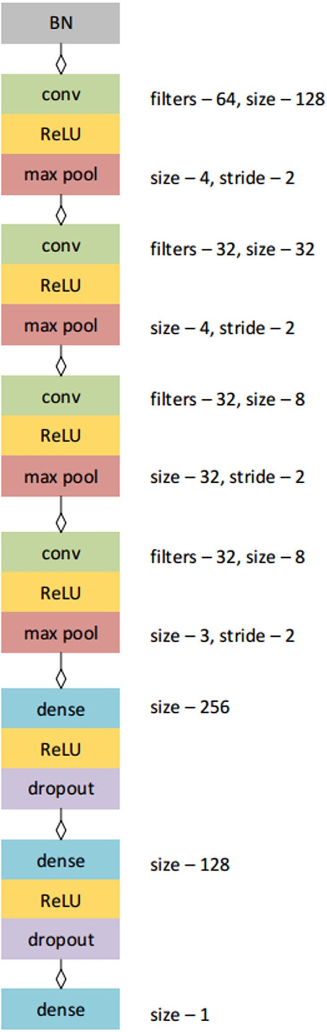
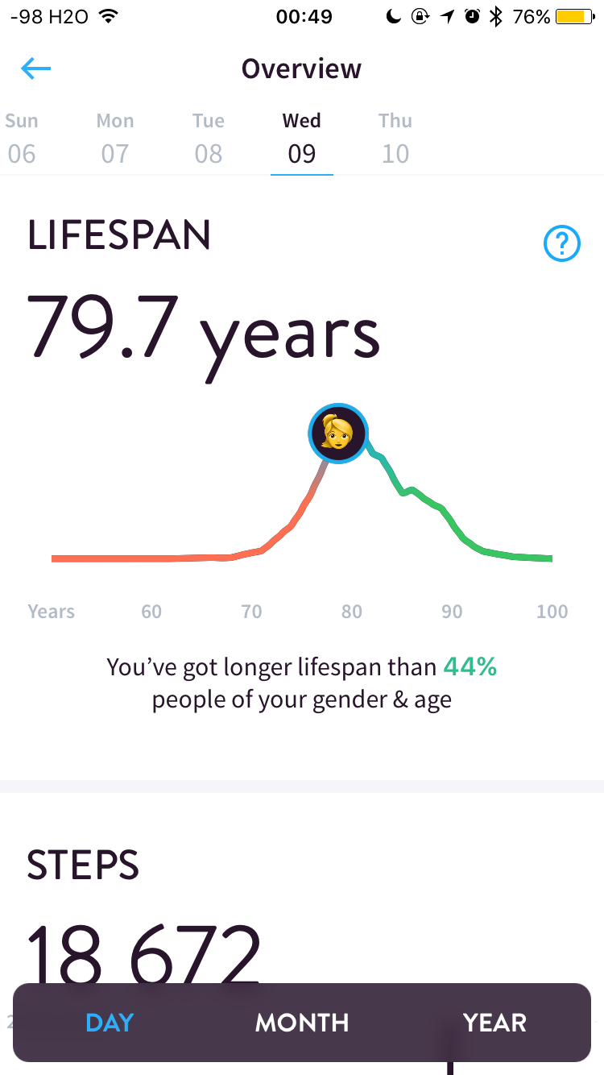
Input
Physical activity data recorded by wearable devices. Each record is a vector of 10080 values representing activity counts.
Output
The predicted age.
Convolution
4 Convolution layers followed by ReLU activation and max pooling.
Classification
2 Fully connected layers followed by ReLu activation and dropout regularization.

Slide 11
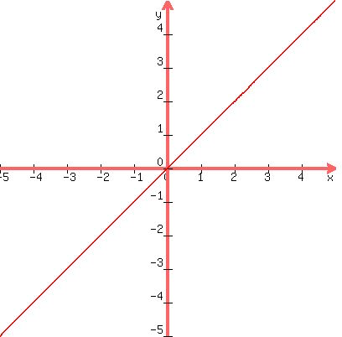
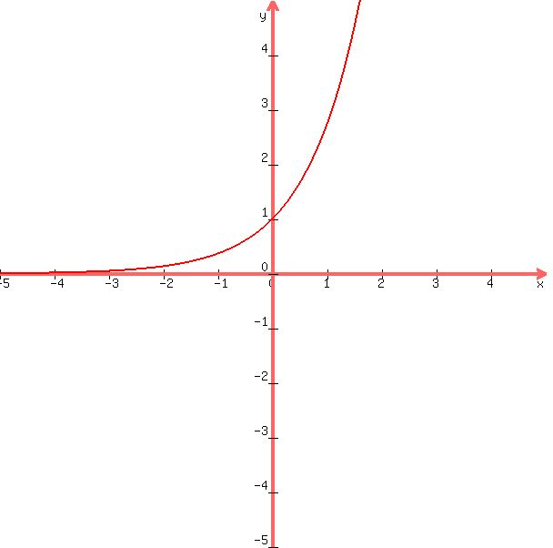

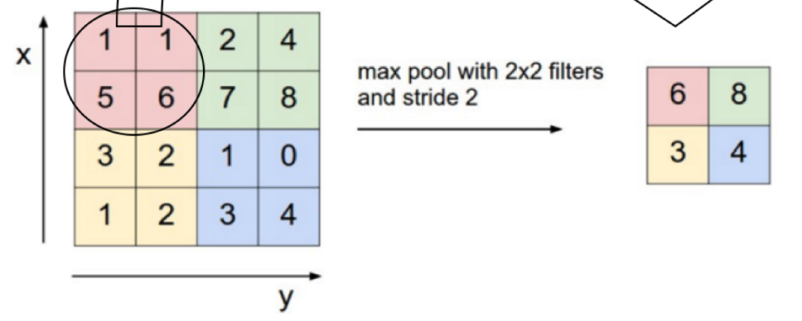
Convolution layer
A filter, or a feature detector, convolves the input and compute dot products.
The output is a feature map, a matrix representation of input data.
Learn the filter patterns on its own during the training process.
Rectified Linear Unit
Introduce non-linearity
Max pooling
Make the input representations smaller and more manageable.

Slide 12
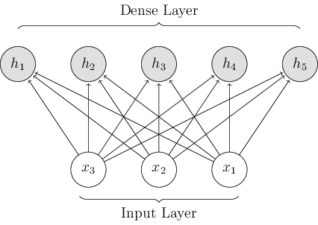
Dense Layer
Also called a fully connected layer.
To classify the input into various classes based on the training dataset.
Dropout
A regularization technique for reducing overfitting in neural networks by preventing complex co-adaptations on training data.
Overfitting: the production of an analysis that corresponds too closely to one particular set of data.

Slide 13
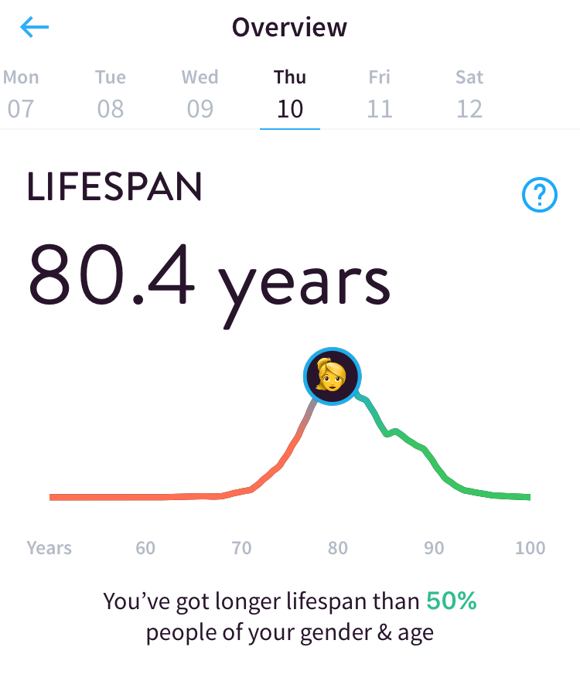
SUMMARY How is the convolutional neural network age model trained?
1
2
3
4
Input
Feeding physical activity records from wearables
Convolution
Sliding filters
ReLU
Max pooling
Classification
Fully connected layer
ReLU
Dropout
Output
A single linear neuron
Resulting value of age prediction

Slide 14
REFERENCE
Culurciello, Eugenio. “The History of Neural Networks”. Dataconomy.com. April 19, 2017. http://dataconomy.com/2017/04/history-neural-networks/
Geitgey, Adam. “Machine Learning is Fun! Part 3: Deep Learning and Convolutional Neural Networks”. Medium.com. Jun 13, 2016. https://medium.com/@ageitgey/machine-learning-is-fun-part-3-deep-learning-and-convolutional-neural-networks-f40359318721
Karn, Ujjwal. “An Intuitive Explanation of Convolutional Neural Networks”. Ujjwalkarn.me. August 11, 2016. https://ujjwalkarn.me/2016/08/11/intuitive-explanation-convnets/
Pyrkov, Timothy. “Extracting biological age from biomedical data via deep learning: too much of a good thing?”. www.nature.com/scientificreports. March 26. 2018. 10.1038/s41598-018-23534-9
“Scientists use AI to predict biological age based on smartphone and wearables data”. Mipt.ru. March 29, 2018. https://mipt.ru/english/news/scientists_use_ai_to_predict_biological_age_based_on_smartphone_and_wearables_data?sphrase_id=231861
“A Beginner’s Guide to Deep Convolutional Neural Networks (CNNs)”. Deeplearning4j.org. https://deeplearning4j.org/convolutionalnetwork

